Slide 1
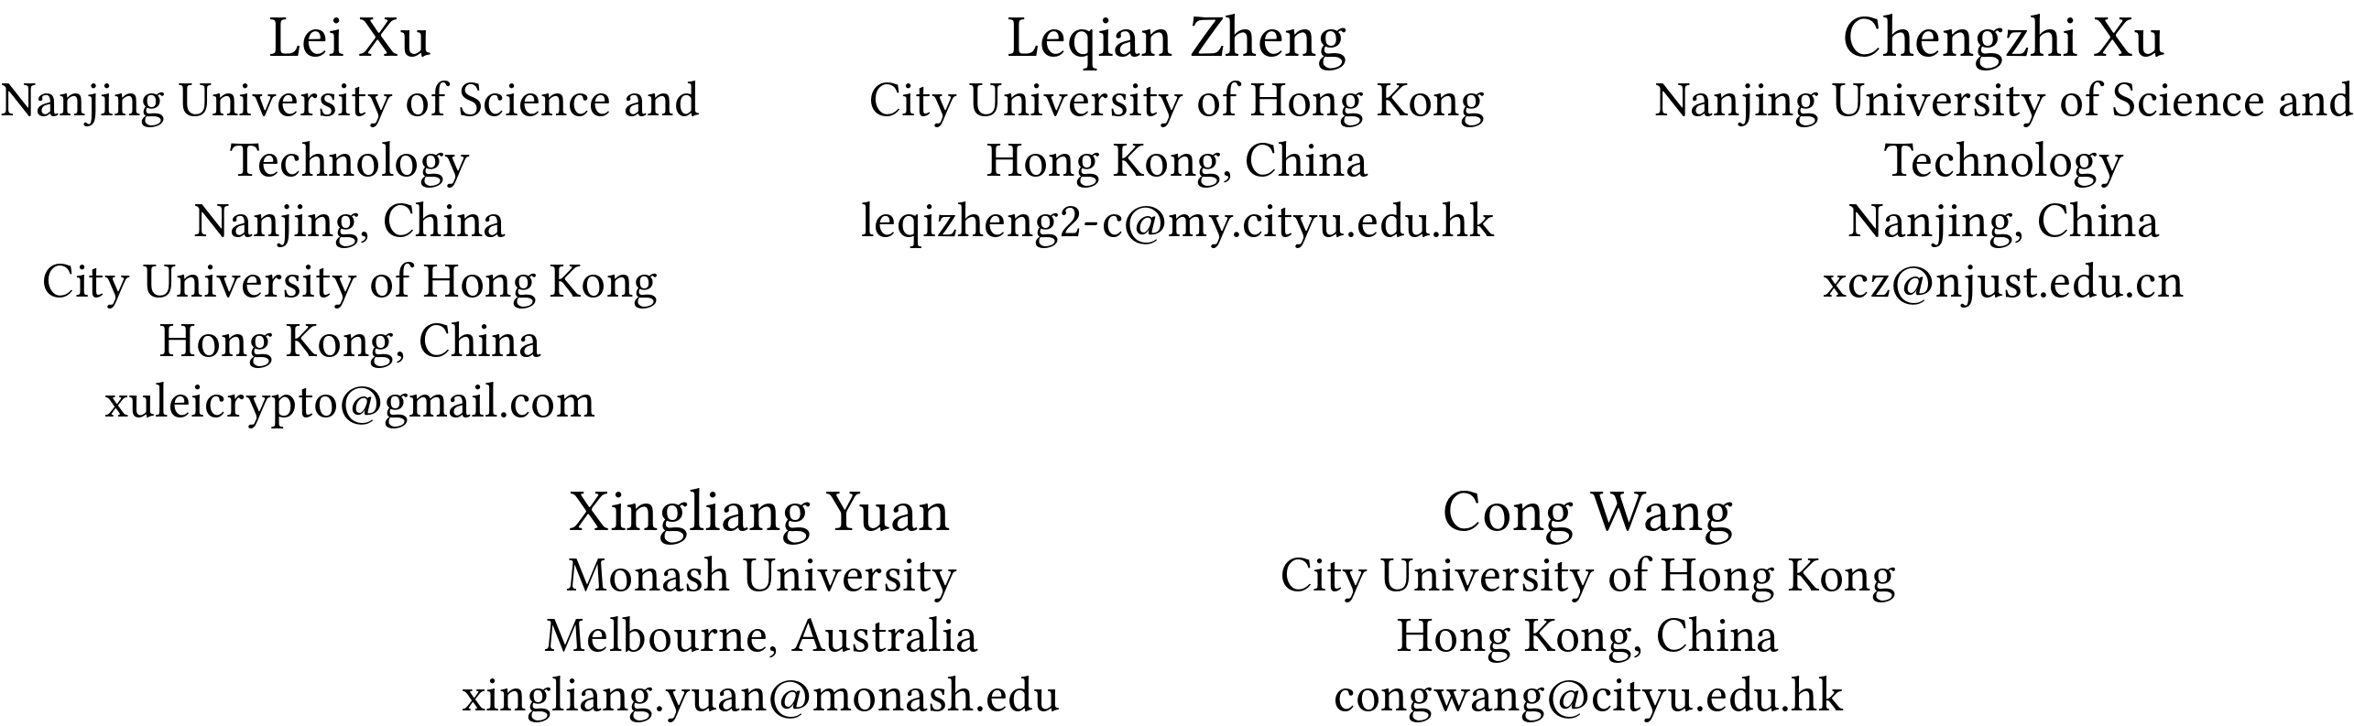
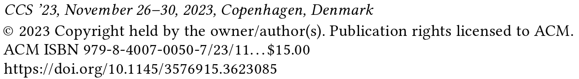
Leakage-Abuse Attacks Against Forward and Backward Private
Searchable Symmetric Encryption
张朝阳
2024.11.29

Slide 2



Searchable Encryption
我的文件太多了，存不下了
Alice存在我这里的是什么东西？？？
Alice
Server
如果Alice在服务器上已存有大量文件，全部下载会占用大量网络带宽，可能造成服务器堵塞；
对已下载的所有文件完全解密会占用大量本地计算资源，效率极低。

Slide 3
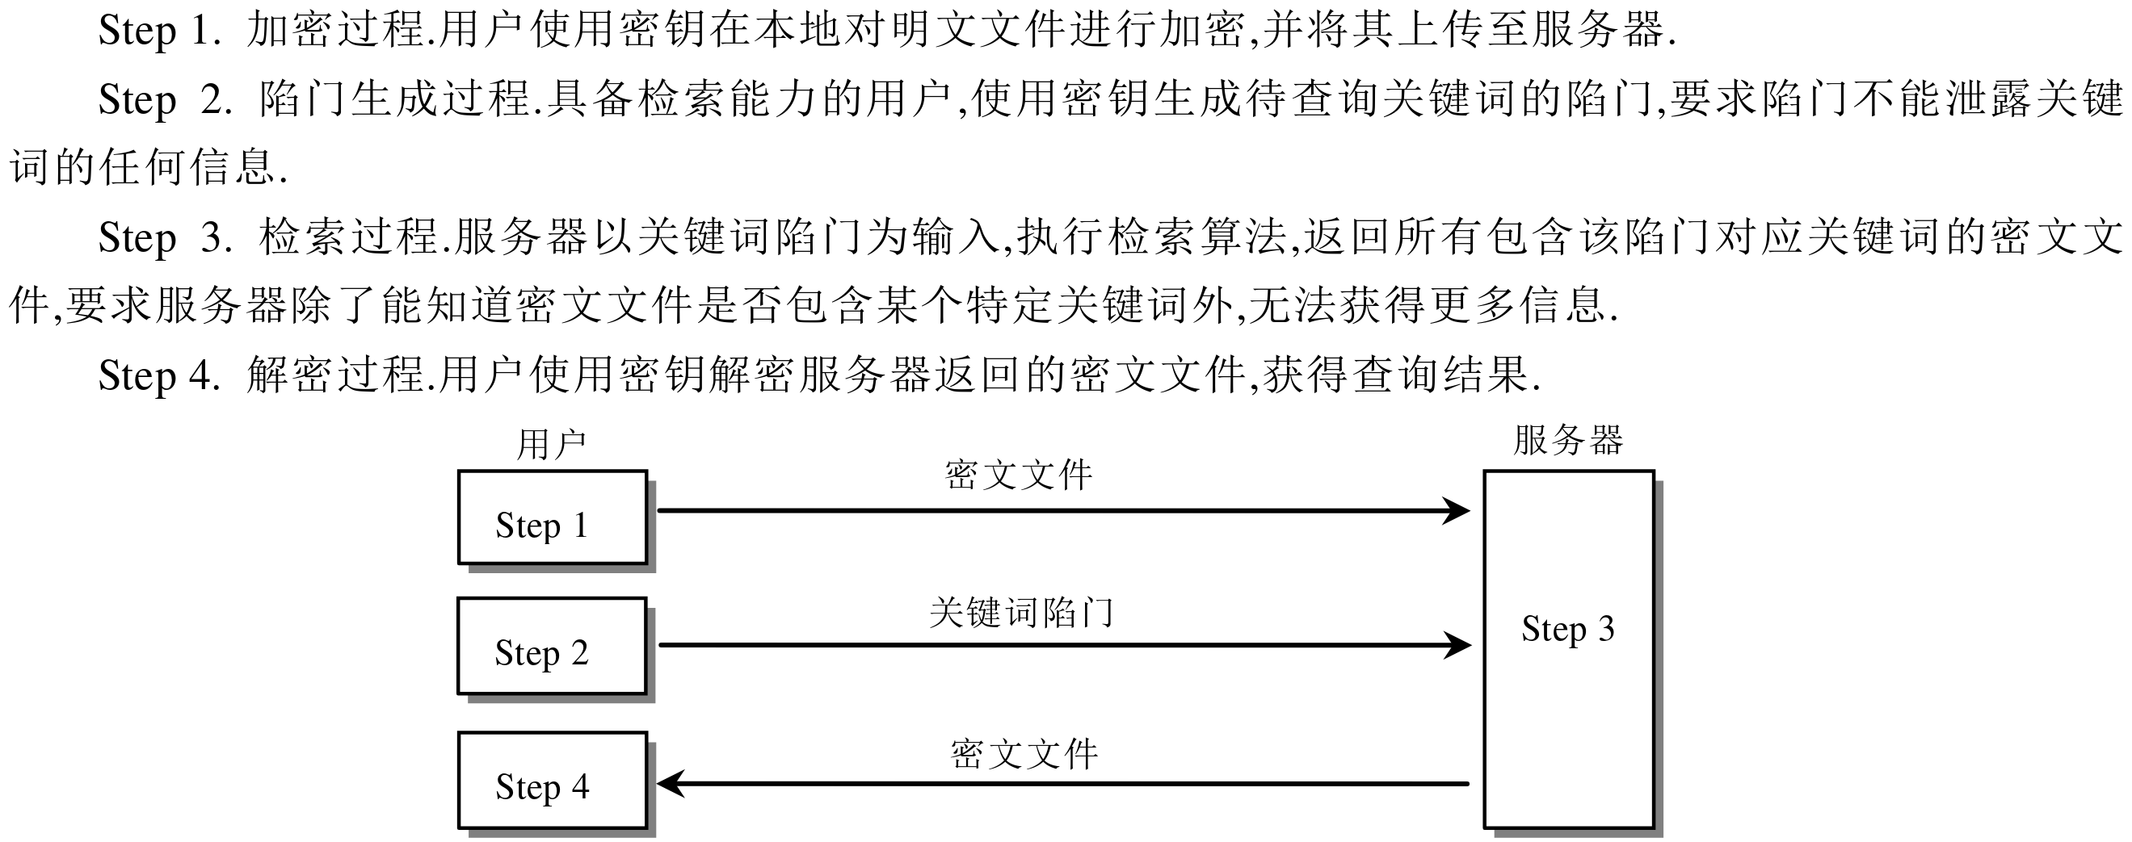
Searchable Encryption

Slide 4
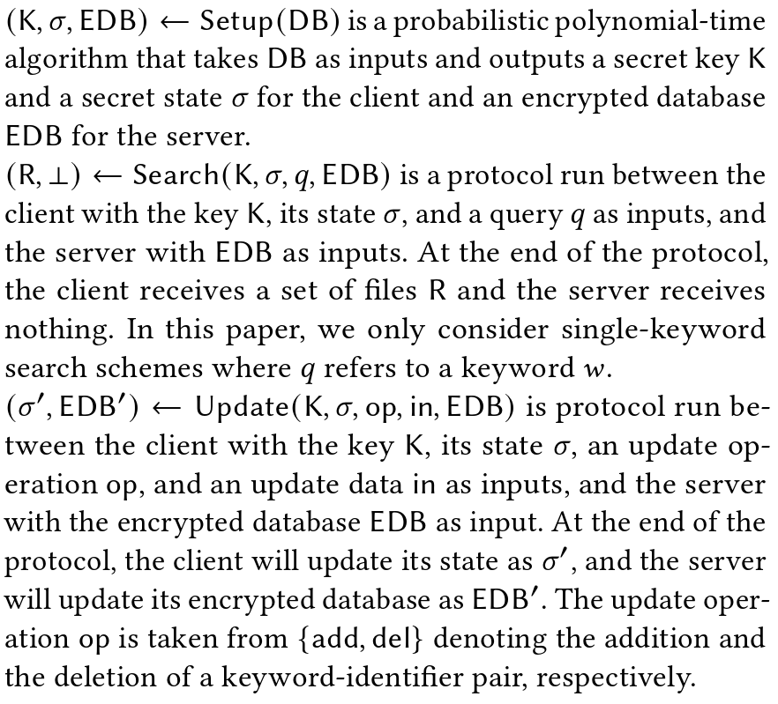
Dynamic Searchable Symmetric Encryption
DSSE =
(Setup, Search, Update)

Slide 5
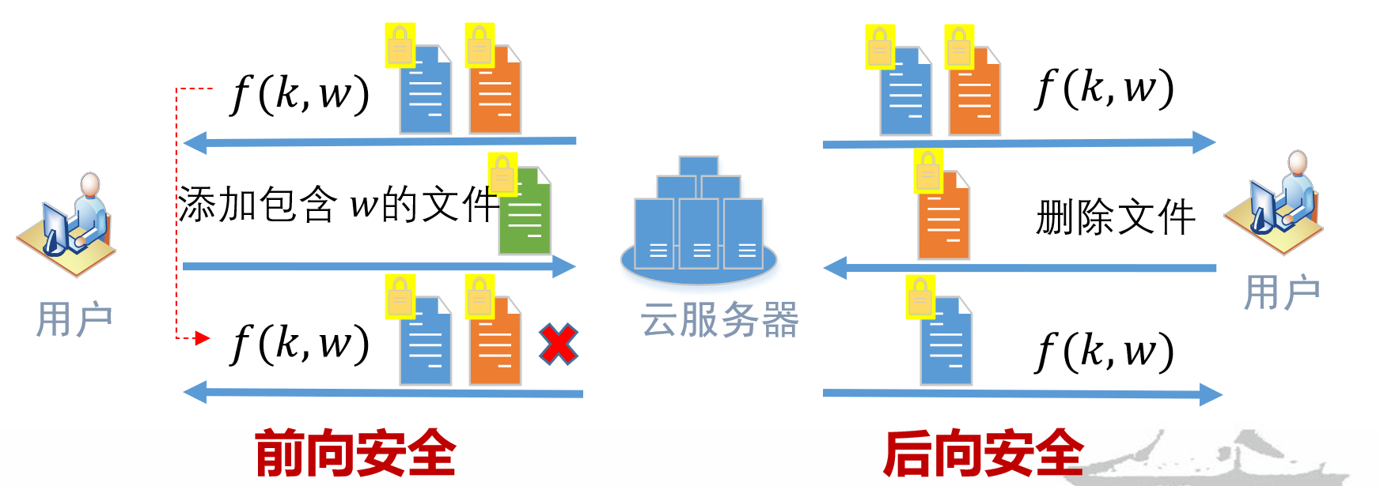
Forward and Backward Private
For forward privacy, it requires that the newly added file/key-word pairs cannot be linked by previous query tokens. This implies that previous query tokens cannot be used to search the above newly added entries.
While for backward privacy, it focuses on the privacy of entries which are added and
deleted later.
对称可搜索加密
动态
对称可搜索加密
支持前后向隐私的动态对称可搜索加密

Slide 6
Question
Is forward and backward dynamic SSE more resilient against LAAs, compared to static SSE?

Slide 7
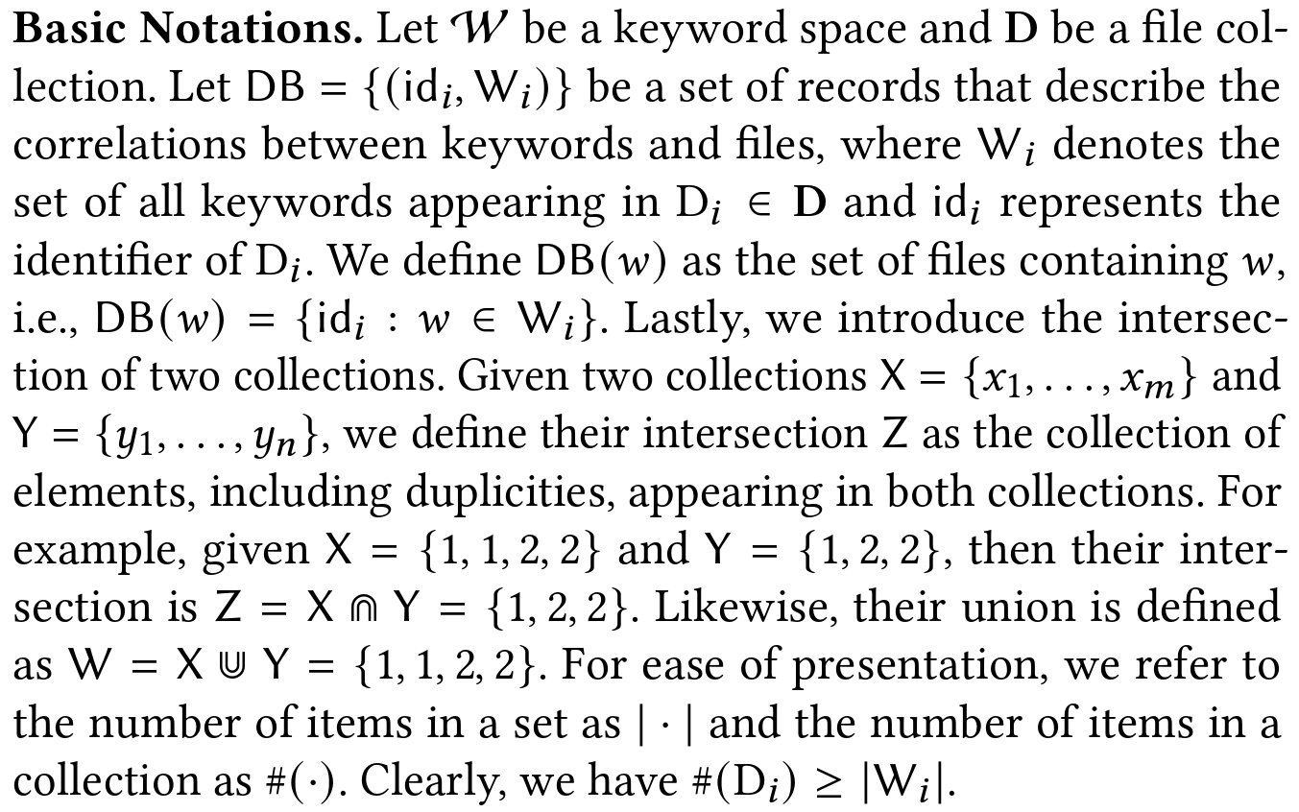
Basic Notations

Slide 8
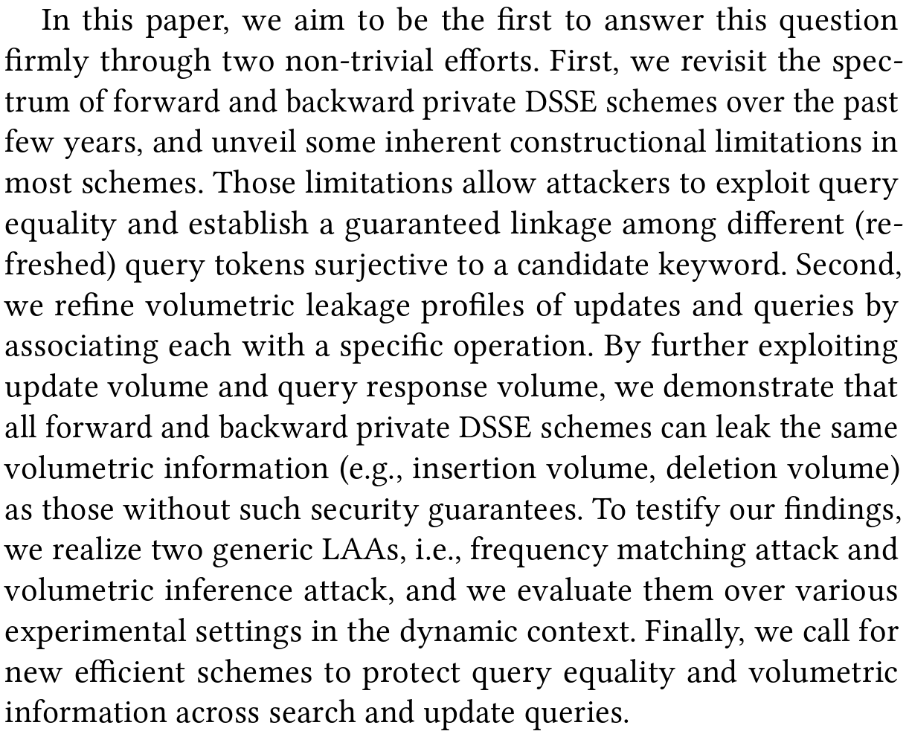
Contributions
Abstract
Refine Leakage Profiles
Modeling Leakage
Volumetric Leakages in BP-DSSE
Query Equality Pattern
Attack Model and Overview
Frequency Matching Attack (FMA)
Volumetric Inference Attack (VIA)

Slide 9
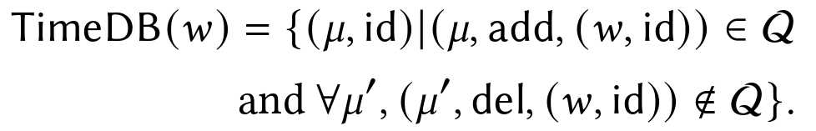
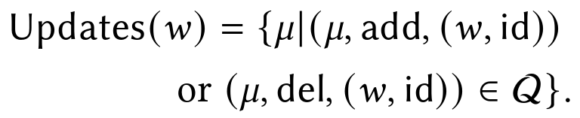
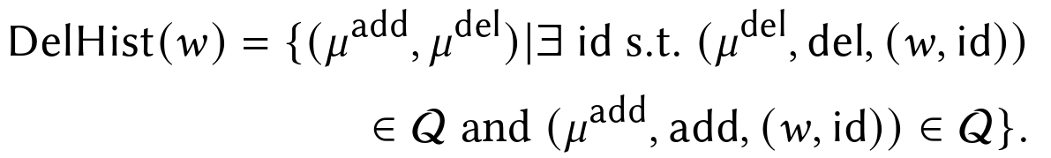
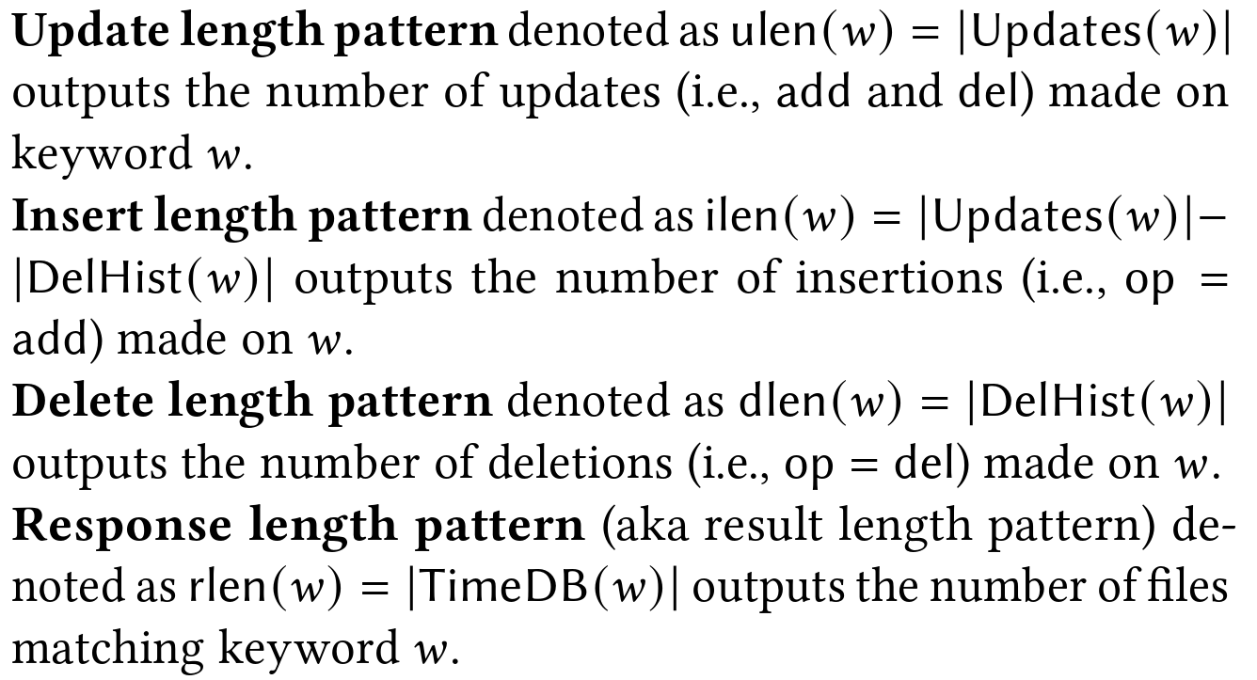
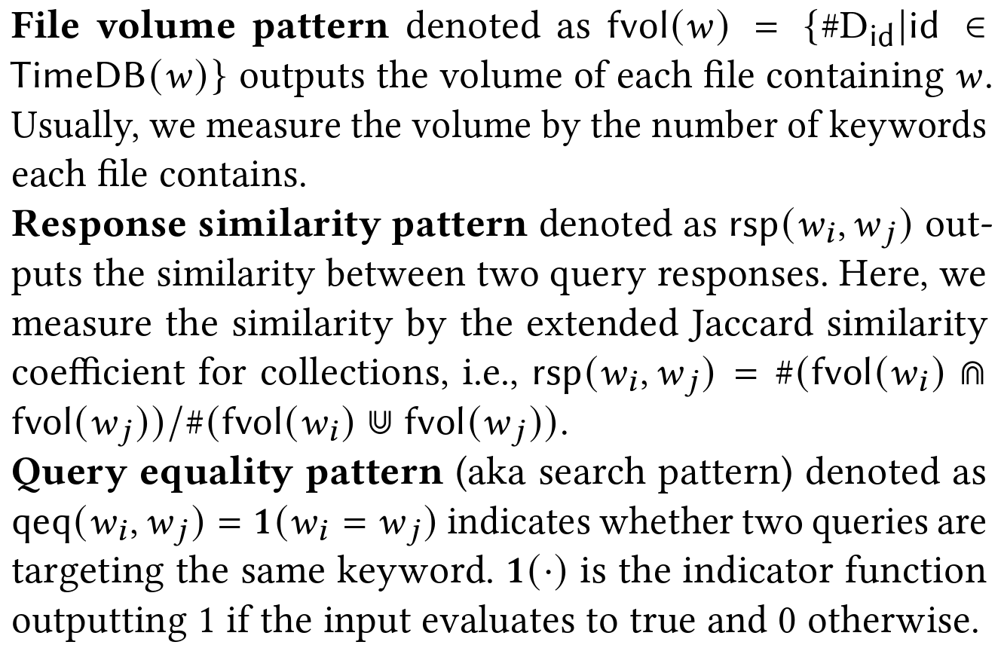

REFINING LEAKAGE PROFILES
1. Modeling Leakage
A query list in the form of ($μ, w$)
timestamp
Search keyword
The number of items in a collection as $\#(⋅)$ or $|⋅|$

Slide 10
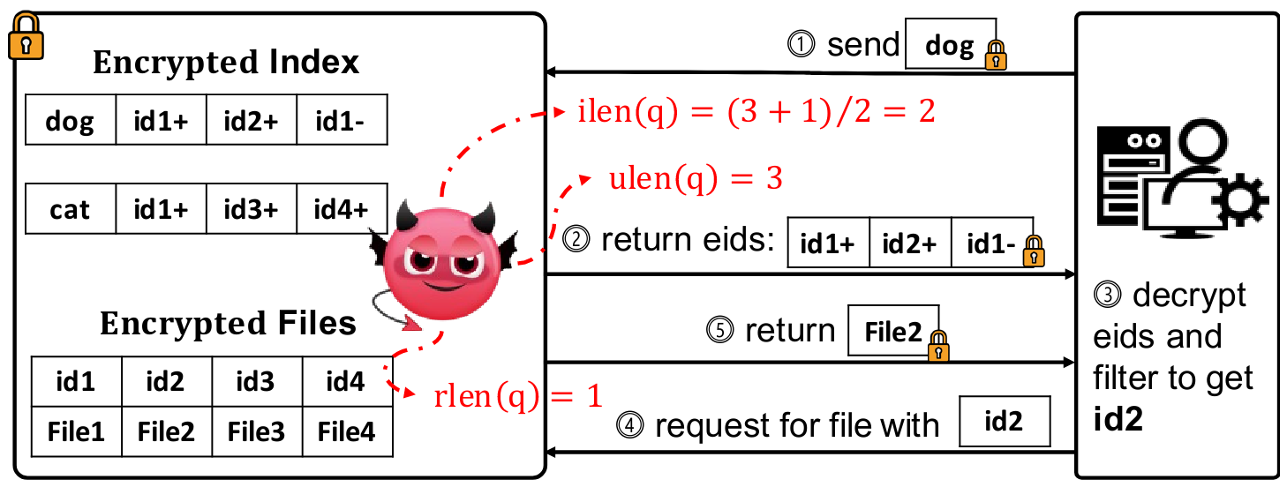
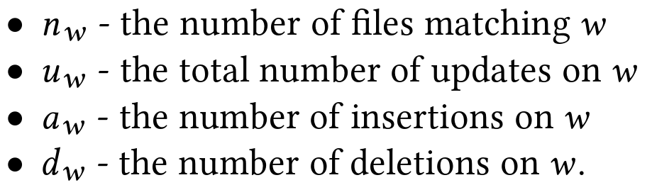
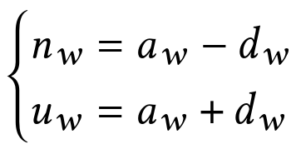
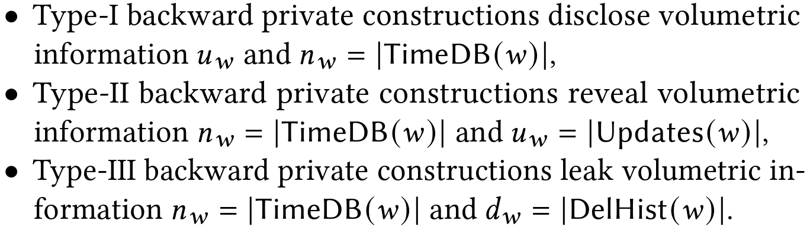
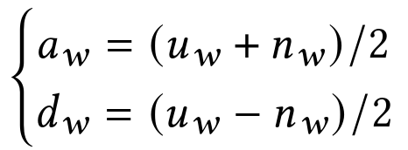
REFINING LEAKAGE PROFILES
2. Volumetric Leakages in BP-DSSE

Slide 11

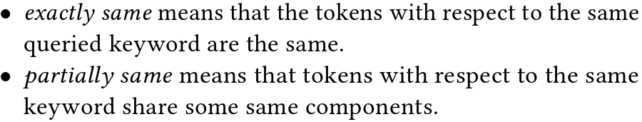
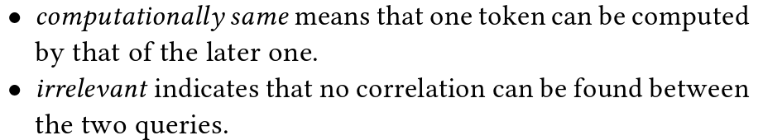
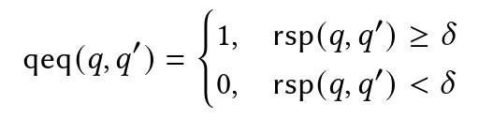


REFINING LEAKAGE PROFILES
3. Query Equality Pattern
That one can rebuild the query equality pattern through these two aspects:
1) the relations of tokens; 2) the similarity of responses.
The responses similarity:
Threshold method
$$T_{w}\text{=(}\text{F}\text{(}\text{K}\text{, }\text{w}\text{), }\text{msk}\text{)}$$

Slide 12
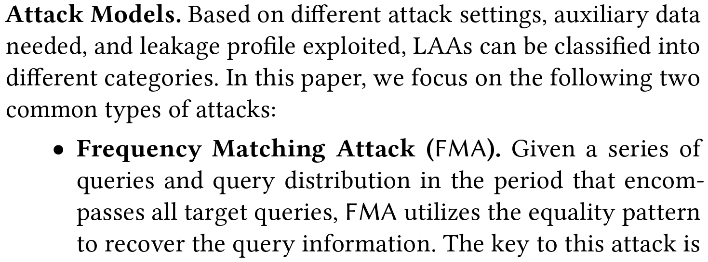
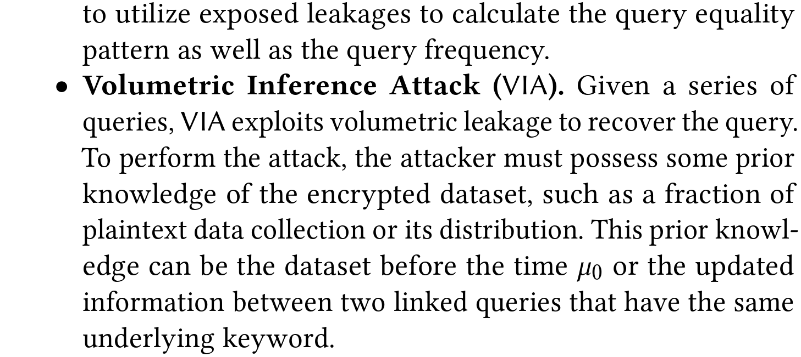
REFINING LEAKAGE PROFILES
4. Attack Model and Overview

Slide 13
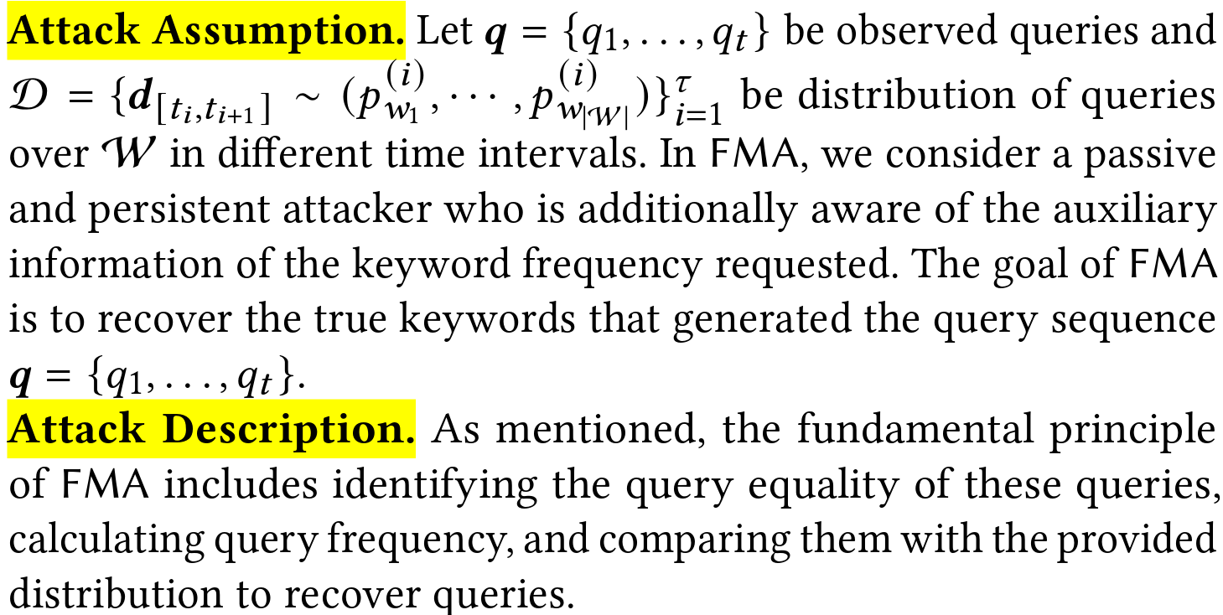
FREQUENCY MATCHING ATTACK

Slide 14
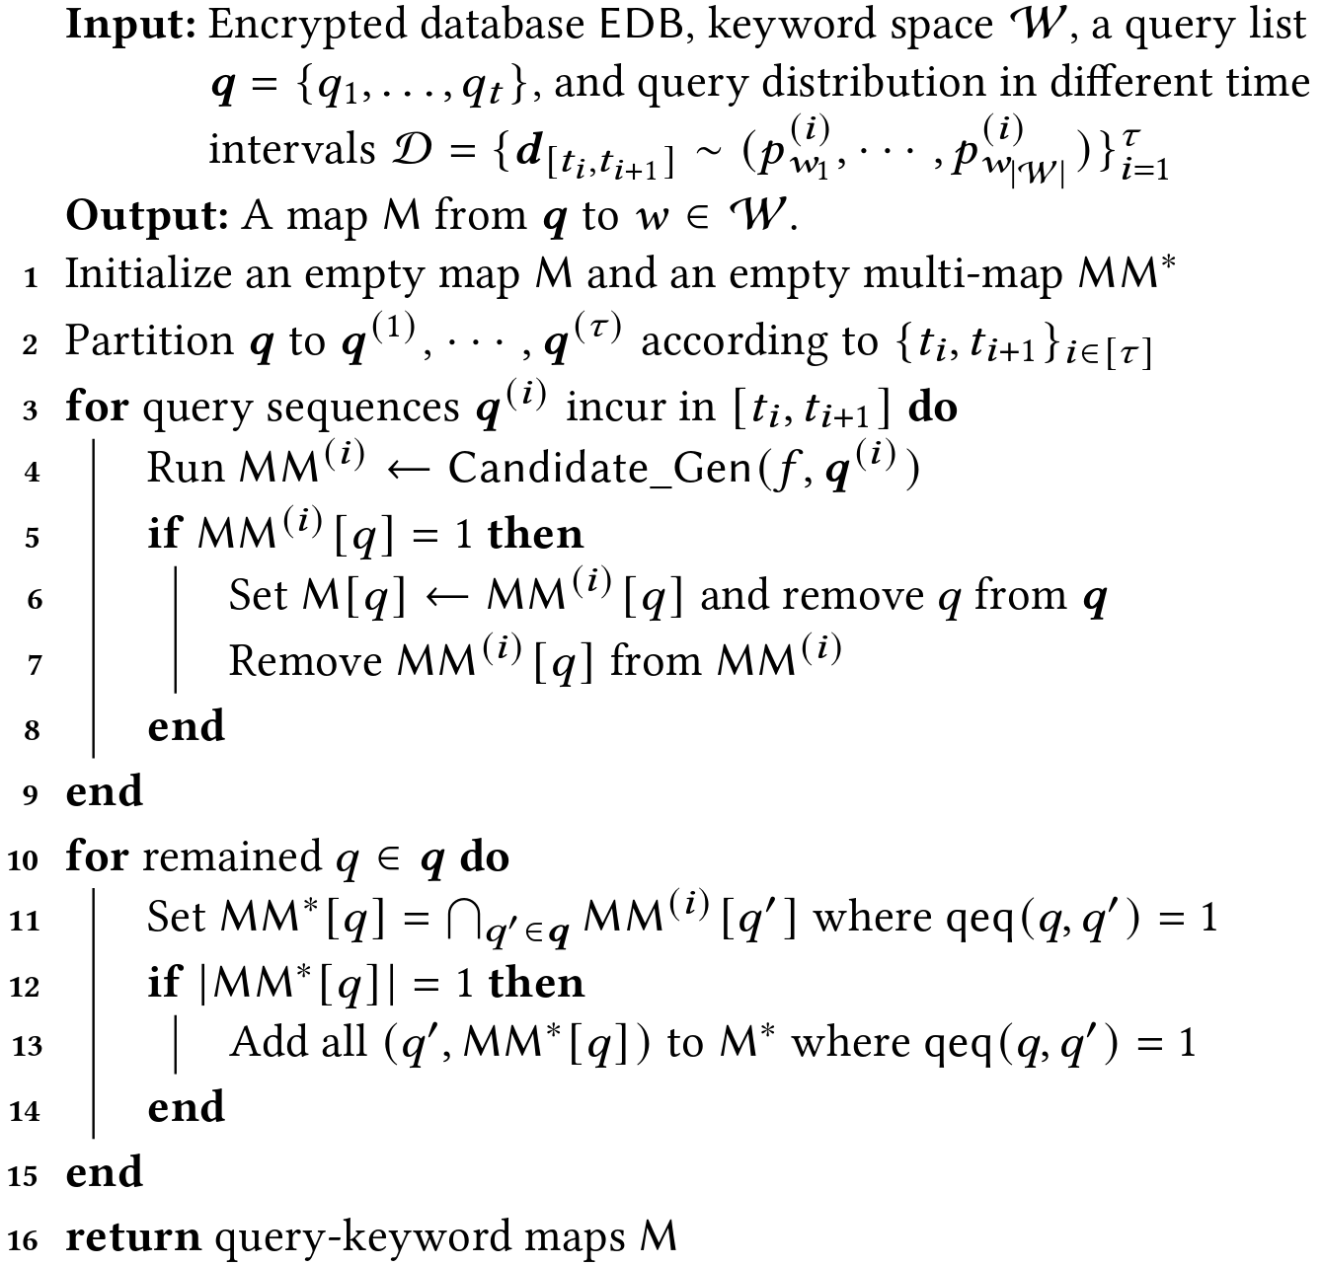
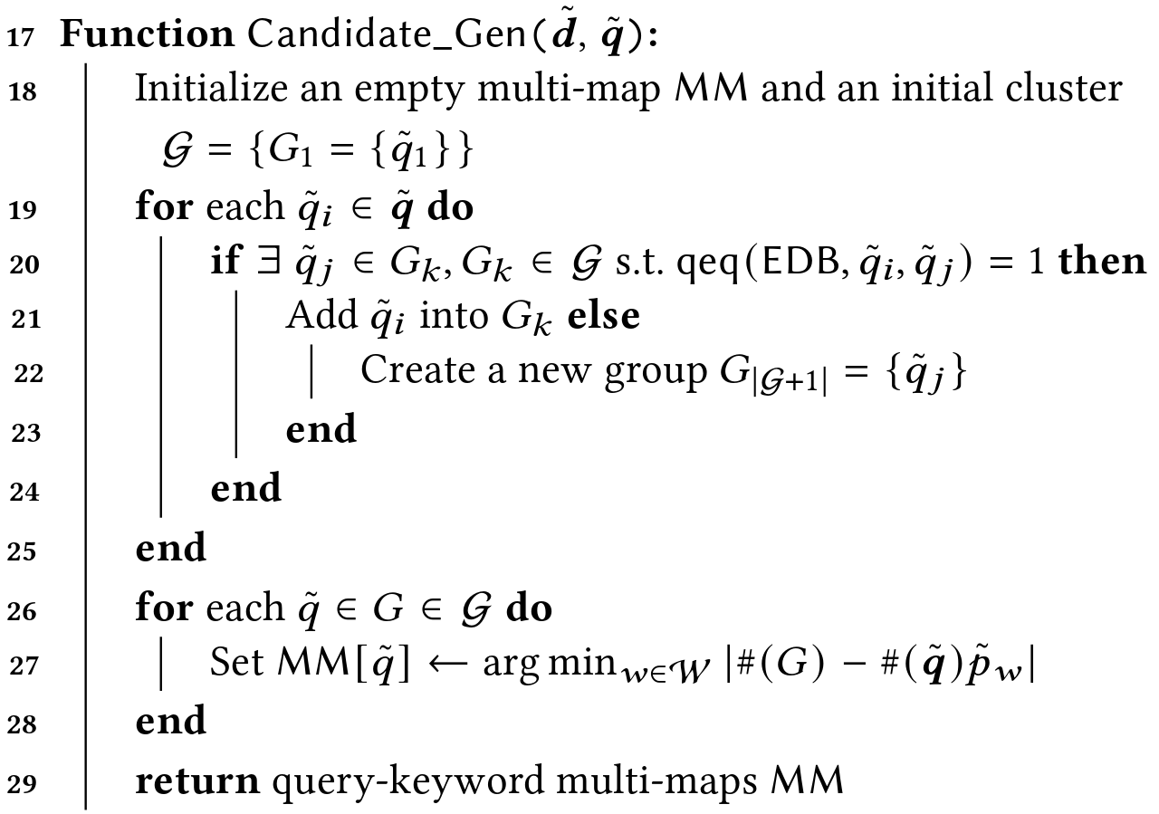
FREQUENCY MATCHING ATTACK

Slide 15
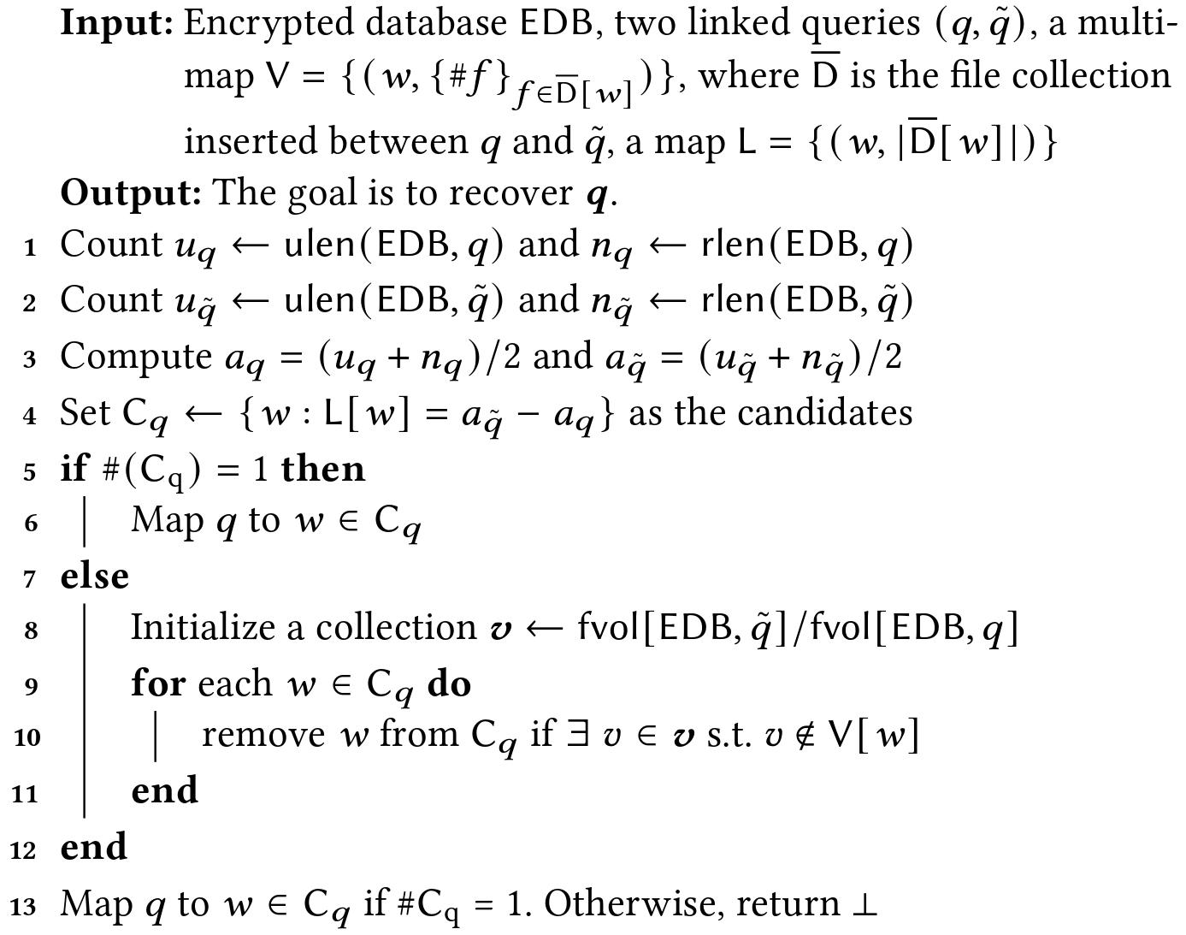
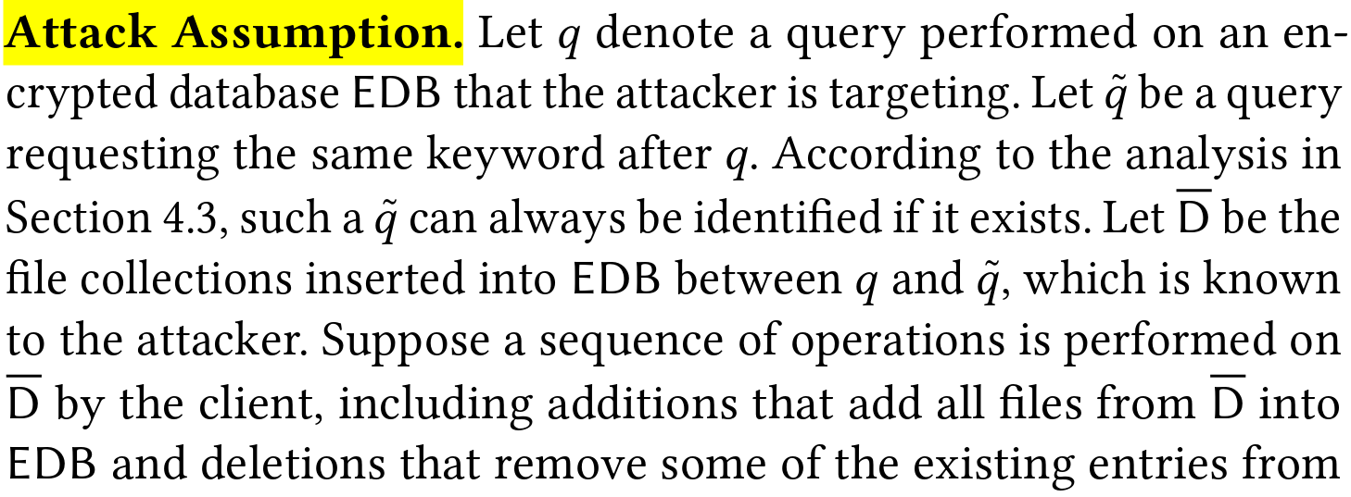
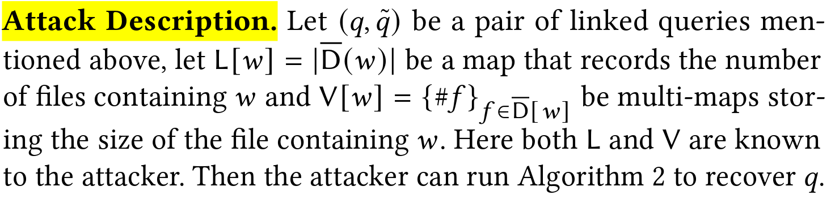
VOLUMETRIC INFERENCE ATTACK
1. VIA: Volumetric Inference Attack

Slide 16
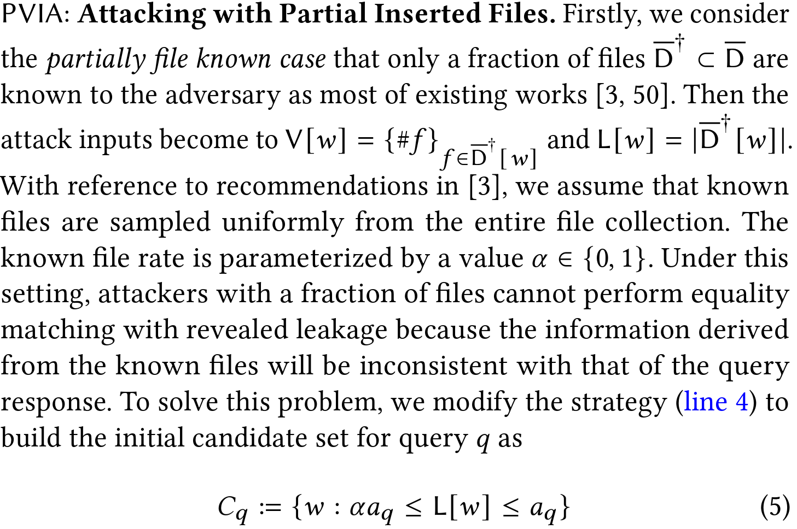
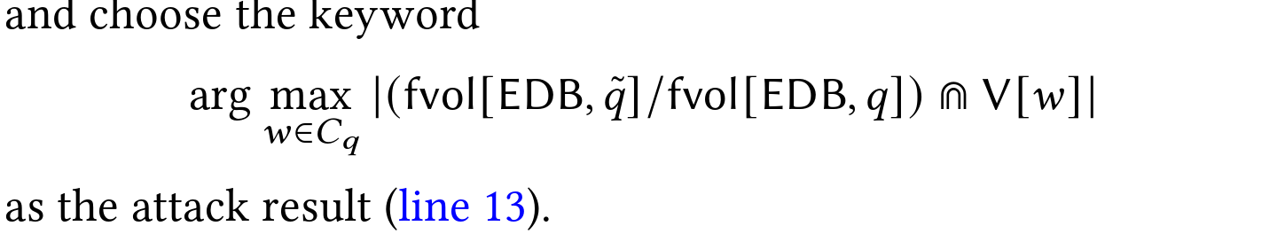
VOLUMETRIC INFERENCE ATTACK
2. Attacks with Limited Prior Knowledge

Slide 17
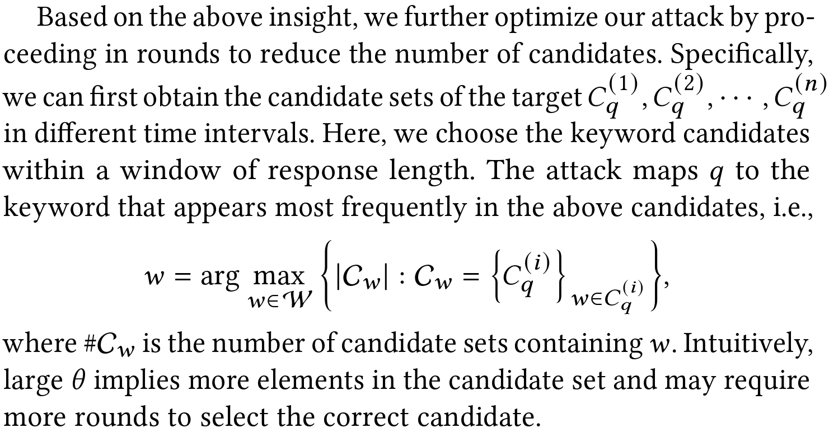
VOLUMETRIC INFERENCE ATTACK
2. Attacks with Limited Prior Knowledge

Slide 18
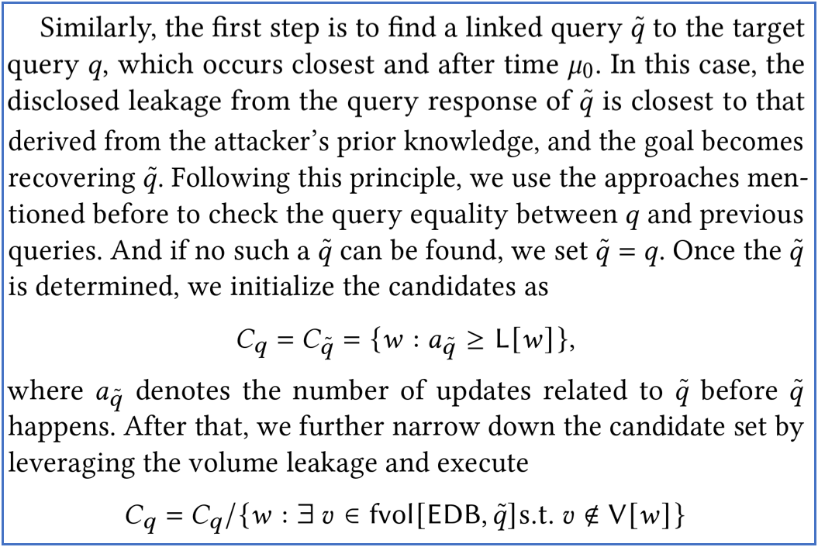
VOLUMETRIC INFERENCE ATTACK
3. Attacks without Prior Knowledge of Updates

Slide 19
Question
Is forward and backward dynamic SSE more resilient against LAAs, compared to static SSE?

Slide 20
Answer
Those DSSE schemes with advanced security properties are also vulnerable to LAAs to a similar extent, compared to the traditional static schemes.

Slide 21
感 谢 观 看
T H A N K Y O U

